Slide 1
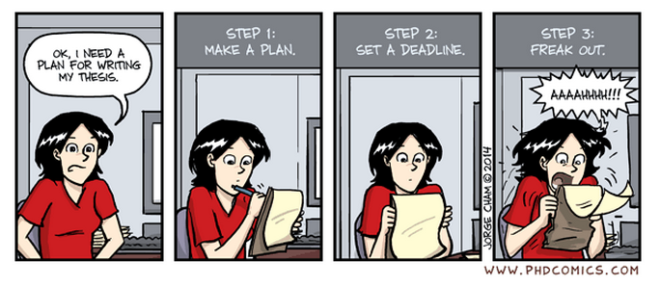

Birmingham International Academy
Thesis Writing for
Scientists and Engineers
Session 3
Tutor’s name: Jane Sjoberg
Please sit near other people

Slide 2
Monday 1 June 3-5pm
Structure/ Introductions/Academic Style)
Tuesday 2 June 3-5pm
Literature Reviews
Wednesday 3 June 3-5pm
Methods/Procedures/Active and Passive)
Thursday 4 June 3-5pm
Results and Discussion
Friday 5 June 3-5pm
Conclusion and abstract

Slide 3

What do you think?
All theses must have a stand-alone chapter with the title ‘Methods’.
Writing about your methods is the easiest section to write in a thesis.
In a thesis, you will only describe your own methods, not those of others.
You should not indicate any limitations of the methods used because this makes your research invalid.

Slide 4

Methods
What is the purpose of writing about methods?

Slide 5
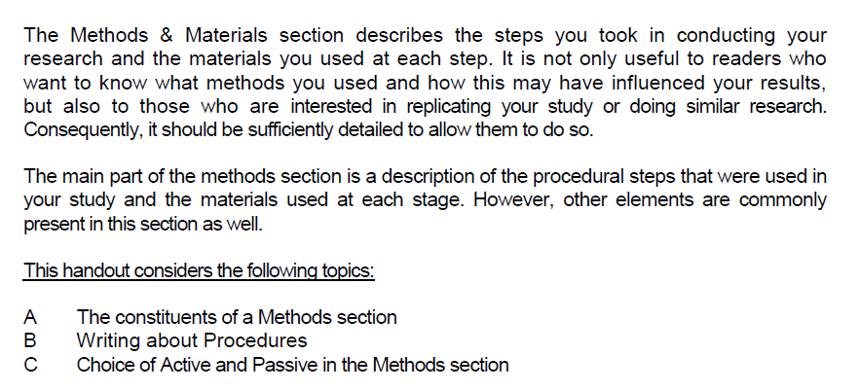

Slide 6
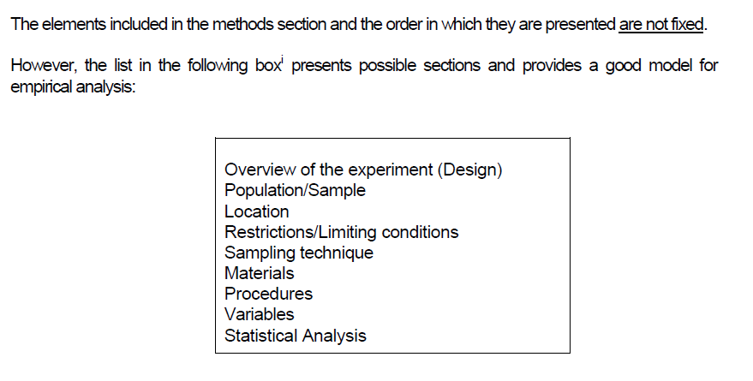
A THE CONSTITUENTS OF
A METHODS SECTION

Slide 7
IDENTIFYING AND SIGNALLING METHODS
Often the pattern is not that straightforward. In many PhD. theses, there may not be a clear (single and separate) ‘methods’ section.
Read the example of a PhD. thesis that has more than one section of ‘methods’ (and more than one literature review) but where the word ‘methods’ is not used in the titles or subtitles.

Slide 8
Can a thesis be without a methods section?
In some types of postgraduate study (particularly at master’s level), a thesis might aim to present and evaluate an analytical approach rather than performing experiments directly and discussing the results.
Some theses, for example, are concerned with proposing a framework for use in future research. In other theses, the main objective may be a detailed analytical and critical review of the available literature in order to identify future research needs.
Most science/engineering research at doctoral level will involve testing/experimentation of some kind so it is likely you will need to report your methods in some form

Slide 9
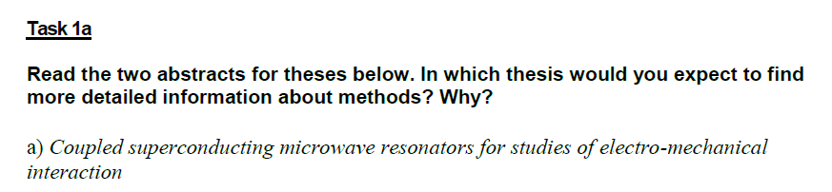
TASK 1A

Slide 10
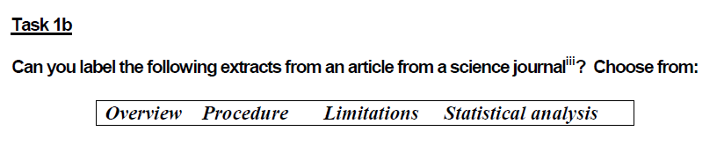

The best way to learn how to write about methods is to read and notice how others do it in your field
NB The sections would not
appear in this order.
Which would come first?

Slide 11
KEY
A. Procedure (this would come second)
B. Overview (this would come first)
C. Limitations
D. Statistical analysis

Slide 12
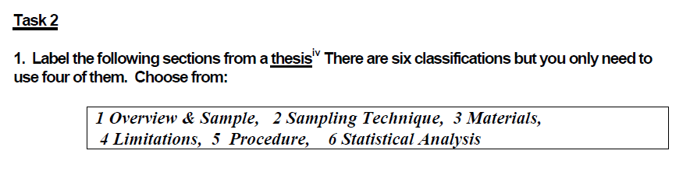
2. Can you put the 4 sections back in their original order?

Slide 13
KEY
A. Procedure
B. Overview and sample
C. Sampling technique
D. Statistical Analysis
Order:
1B
2C
3A
4D

Slide 14
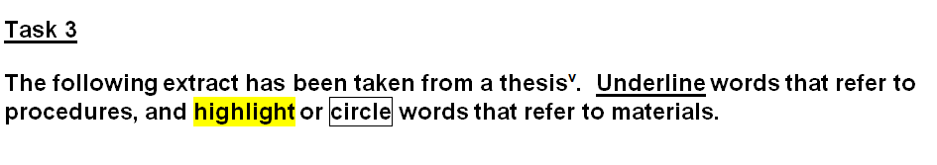

B WRITING ABOUT PROCEDURES

Slide 15
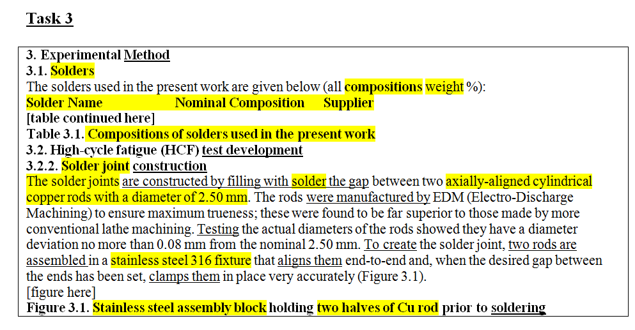
KEY

Slide 16
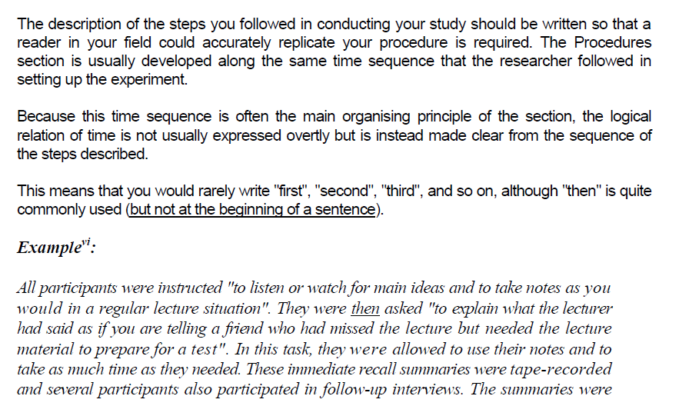
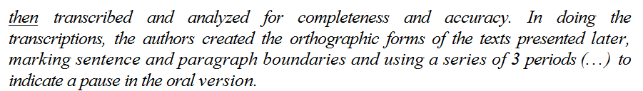

Slide 17
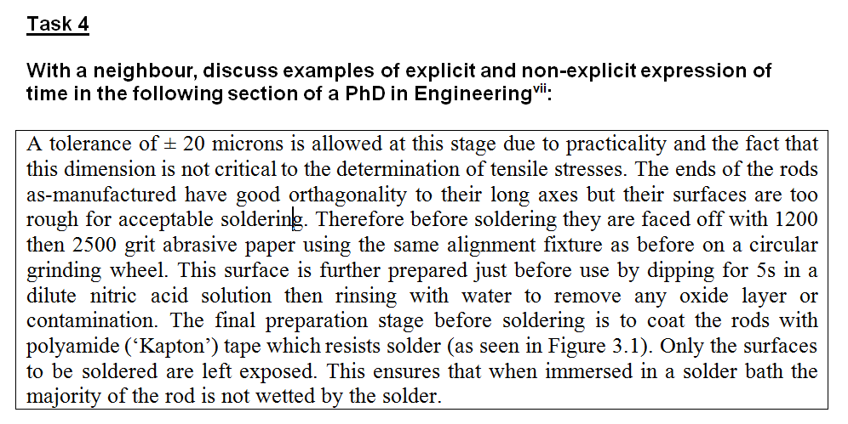
Underline expressions that indicate time/sequence

Slide 18
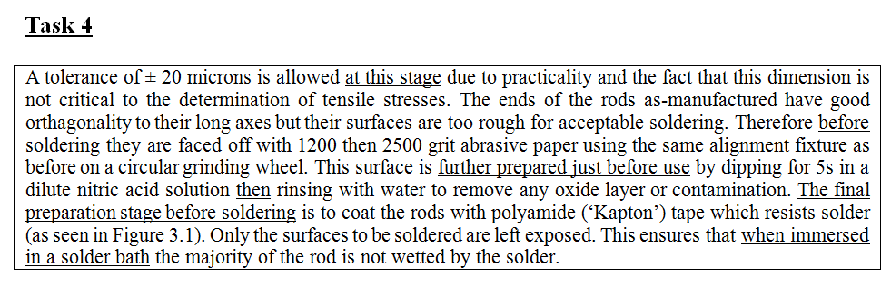
KEY

Slide 19
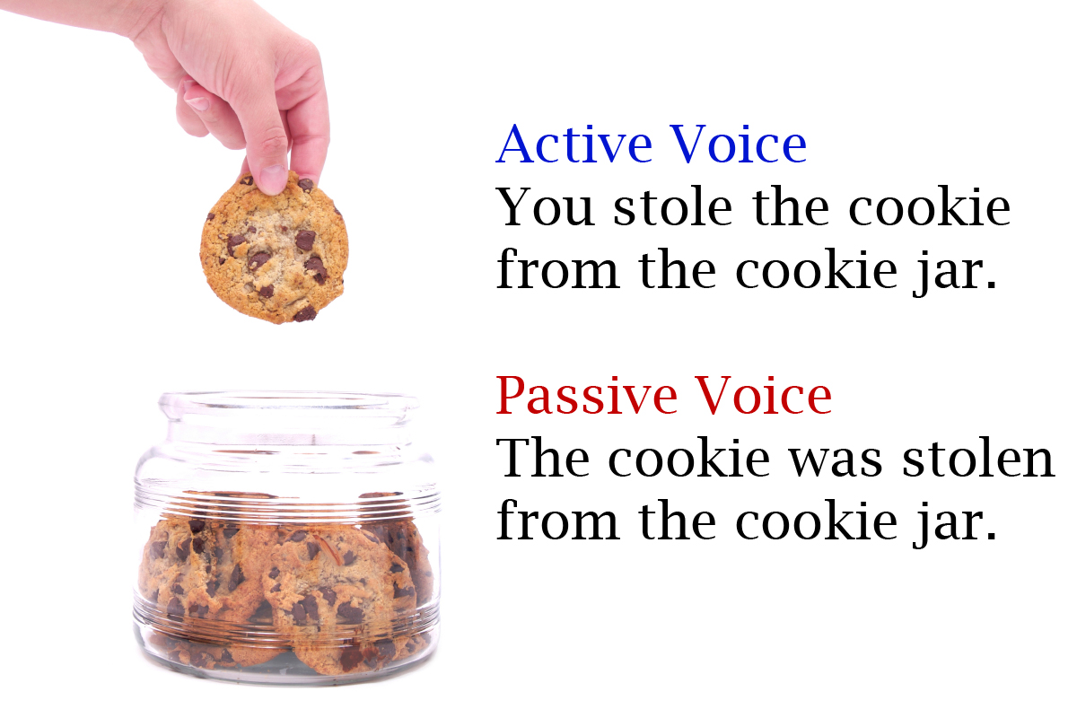
C CHOICE OF ACTIVE AND PASSIVE IN THE METHODS SECTION
Source: blitzmetrics.com

Slide 20
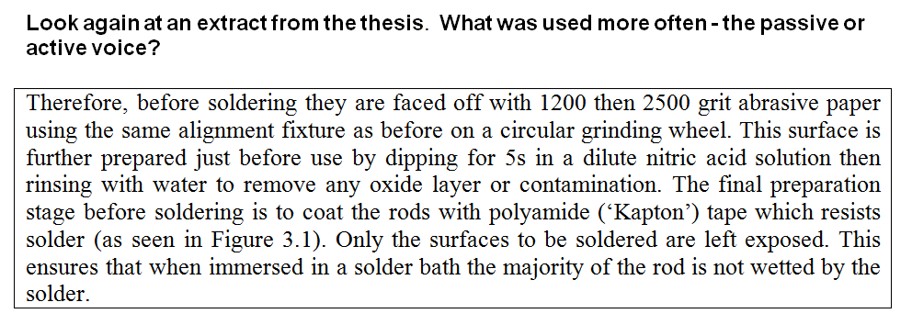
IDENTIFYING PASSIVES

Slide 21

Why use passives?
Why does scientific academic writing make such heavy use of passives?
Are there any cases when passives might NOT be a good idea?

Slide 22
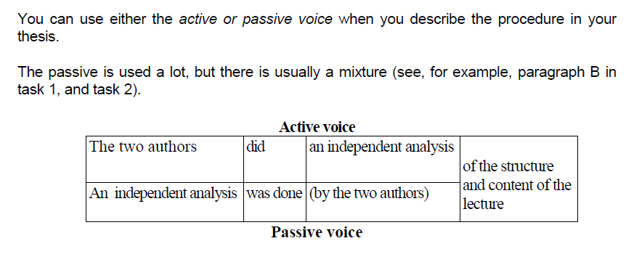

Slide 23
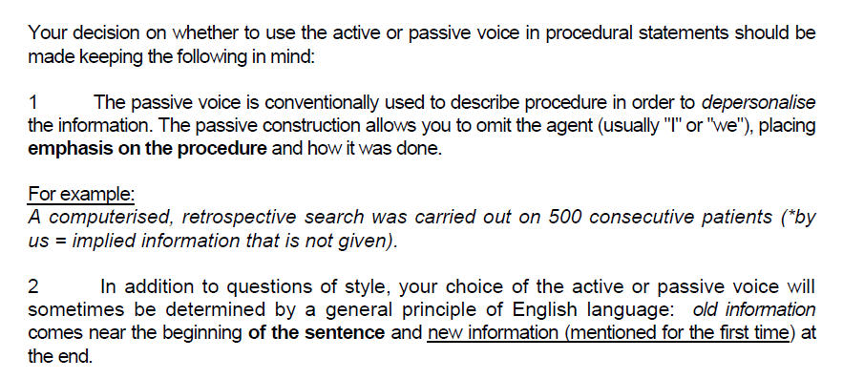

Slide 24
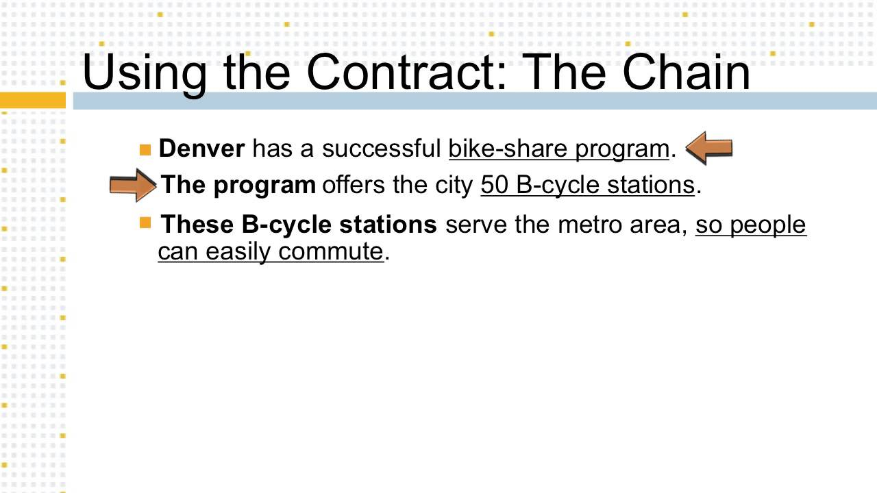
THE KNOWN – NEW PRINCIPLE

Slide 25
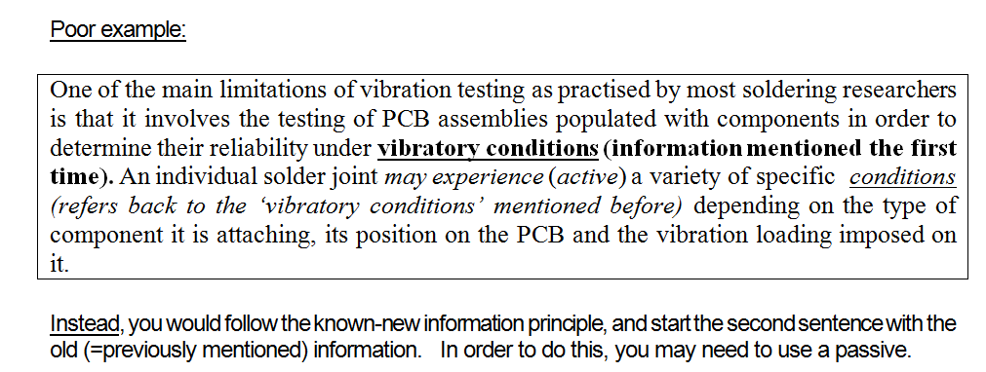
THE KNOWN – NEW PRINCIPLE

Slide 26
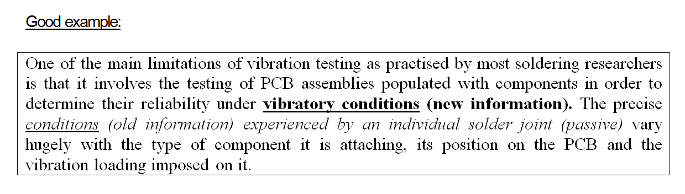

Slide 27
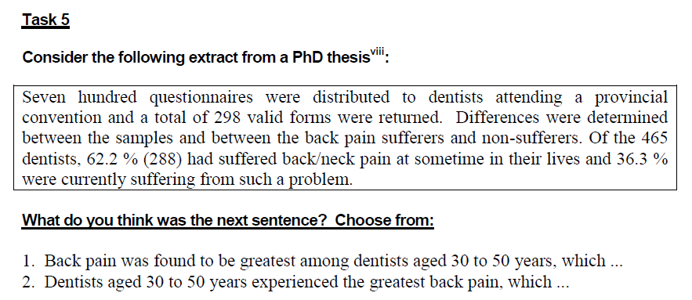

Slide 28
KEY
Both sentences are possible, depending on the focus of the next part of the text.
In the original text, the author chose sentence 1 (Back pain was found to be greatest among dentists aged 30 to 50 years, which ...), probably because she wanted to pick up the previously mentioned issue of back pain, which (as old information) is put at the beginning of the sentence.
This then leads to the use of the passive.

Slide 29

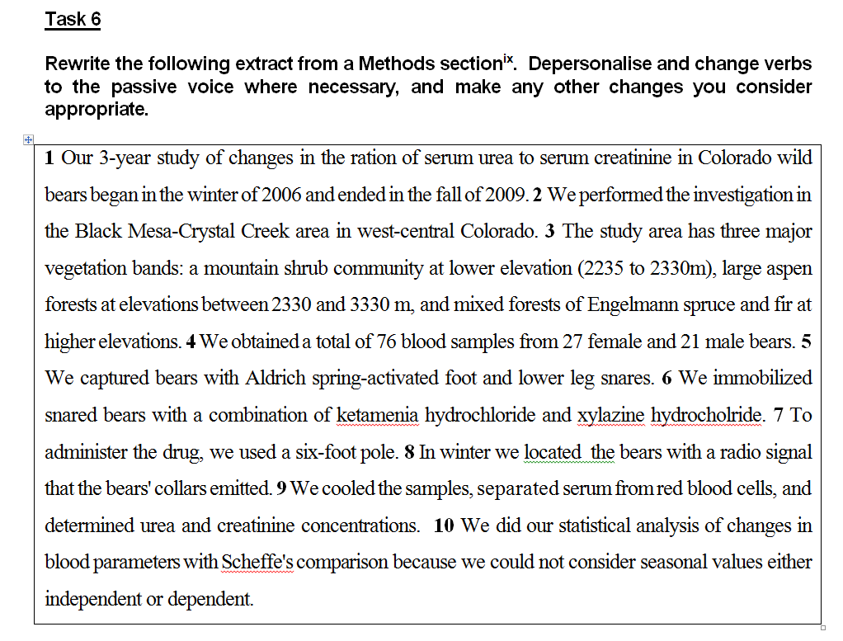
DISCUSSIONS

Slide 30
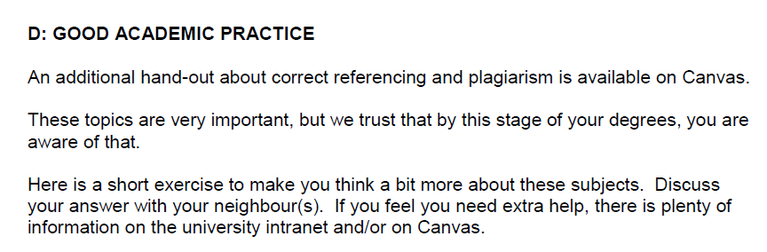

Slide 31
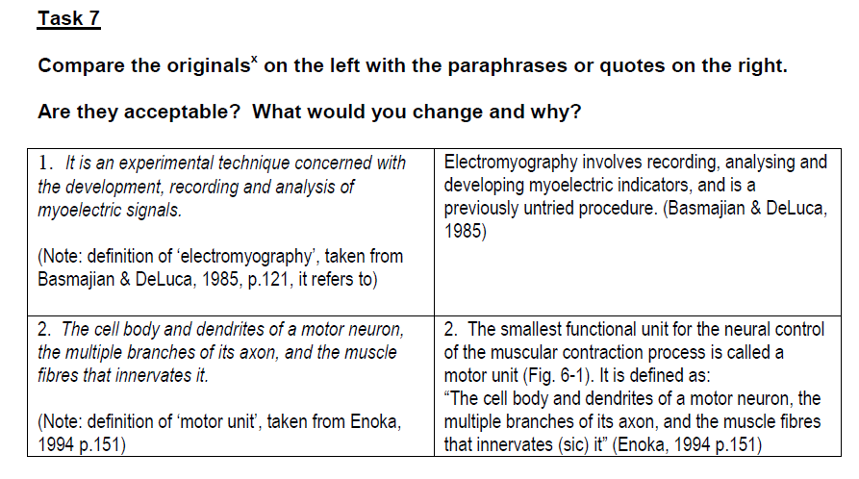

Slide 32
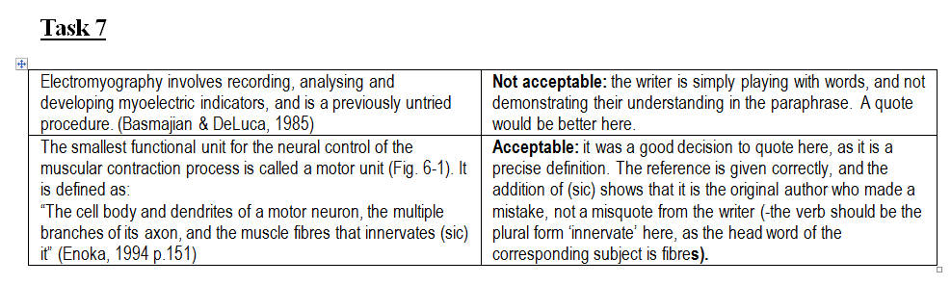

Slide 33
When direct quoting is a bad idea…
Direct quotes in science are much rarer than in other disciplines
Be careful not to use direct quotes (or ‘the dictionary defines X as ….’ simply as a way of avoiding writing in your own words
Avoid direct quotes of common knowledge or facts
E.g.
As Jones (1998:45) points out, ‘The two most familiar alloys of copper are bronze and brass’. ☹
‘The University of Birmingham is situated in the West Midlands and was founded in 1900 by Joseph Chamberlain’ (Roberts, 2007, p. 14) ☹

Slide 34
Coming up….
Thursday 4 June
Results
Discussions
The Language of:
Comparison
Explanation
Claims
Support
Recommendation
Friday 5 June
Conclusions
Abstracts

